Slide 1

EXPLORATORY DATA ANALYSIS
- For a SUPERSTORE
Assigned as TASK 5 of the Internship with SPARK Foundation

Slide 2
Introduction to Dataset
The dataset represents the Sales of its THREE CATEGORY of Goods across UNITED States – of a SUPERSTORE.
The goods are primarily sold to THREE Segments of Customers .
The Profitability is accounted against each sales made.
We will be attempting to understand the distribution of Profitability across Category of goods as well as the Sales distribution across the cities in USA.

Slide 3
DATA Report -
The total Transactions in the Superstore can be classified, Category wise as –
Furniture ➔ 2121 Transactions
Office Supplies ➔ 6026 Transactions
Technology Goods ➔ 1847 Transactions.
SUB-Category wise –
Furniture has 04 Sub-categories of goods – Bookcases; Chairs; Furnishings & Tables.
OFFICE SUPPLIES has 09 Sub-Categories of goods – Appliances; Art; Binders; Envelops; Fasteners; Labels; Paper; Storage & Supplies.
TECHNOLOGY has 04 Sub-Category of goods – Accessories; Copiers; Machines & Phones.
SALES –
Sales has taken place across 531 Cities spread out in 49 States of the UNITED States.
Sales measures indicate MAXIMUM Sales from the states of Washington; New York; California & Pennsylvania.
REGION Wise sales – All the FOUR Regions have been covered proportionately – SOUTH Region having the least transactions & WEST region having the Maximum transactions.

Slide 4
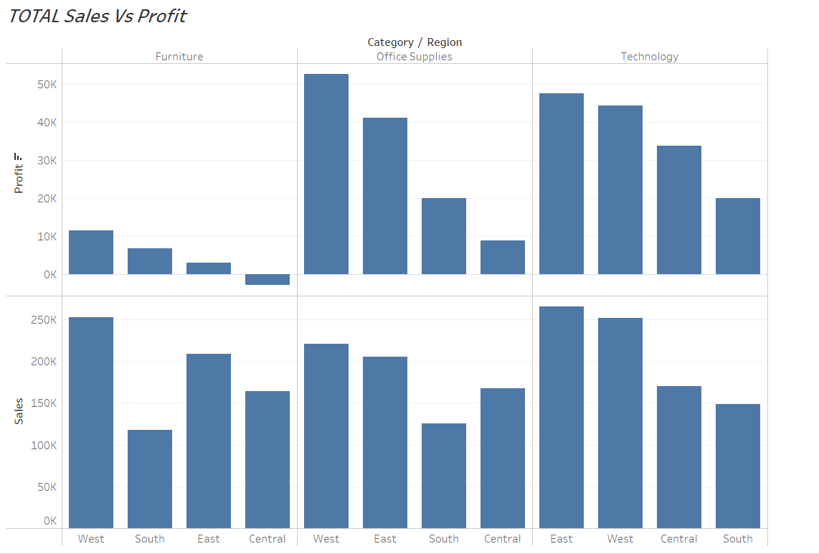
Univariate Analysis -
REGION Wise Sales & Profit Analysis-
Category of Goods | MAXIMUM SALES | MINIMUM SALES | MAXIMUM PROFIT | MINIMUM PROFIT | LOSS MAKING
FURNITURE | WEST Region | SOUTH Region | WEST Region | EAST Region | CENTRAL Region
OFFICE Supplies | WEST Region | SOUTH Region | WEST Region | CENTRAL Region | NIL
TECHNOLOGY | EAST Region | SOUTH Region | EAST Region | SOUTH Region | NIL
Click for Live Visualisation

Slide 5
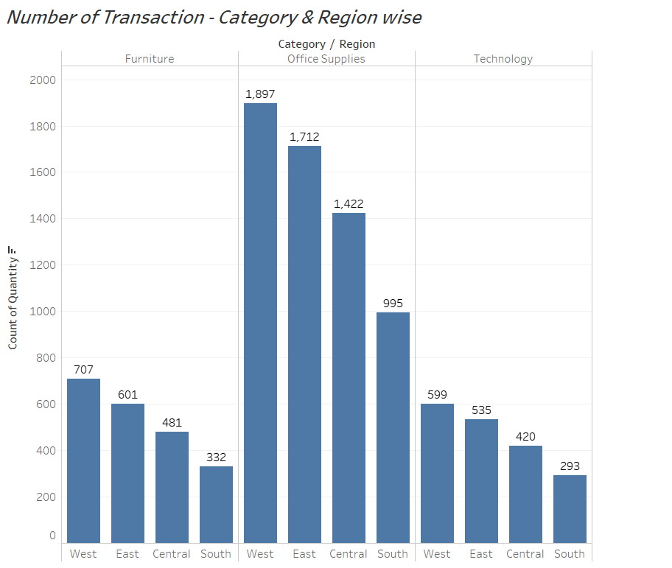
Univariate Analysis –
Category Wise Transaction Volume analysis –
Category of Goods | NUMBER OF TRANSACTION
 | WEST Region | EAST Region | SOUTH Region | CENTRAL Region
FURNITURE | 707 | 601 | 332 | 481
OFFICE Supplies | 1897 | 1712 | 995 | 1422
TECHNOLOGY | 599 | 535 | 293 | 420
Click for Live Visualisation

Slide 6
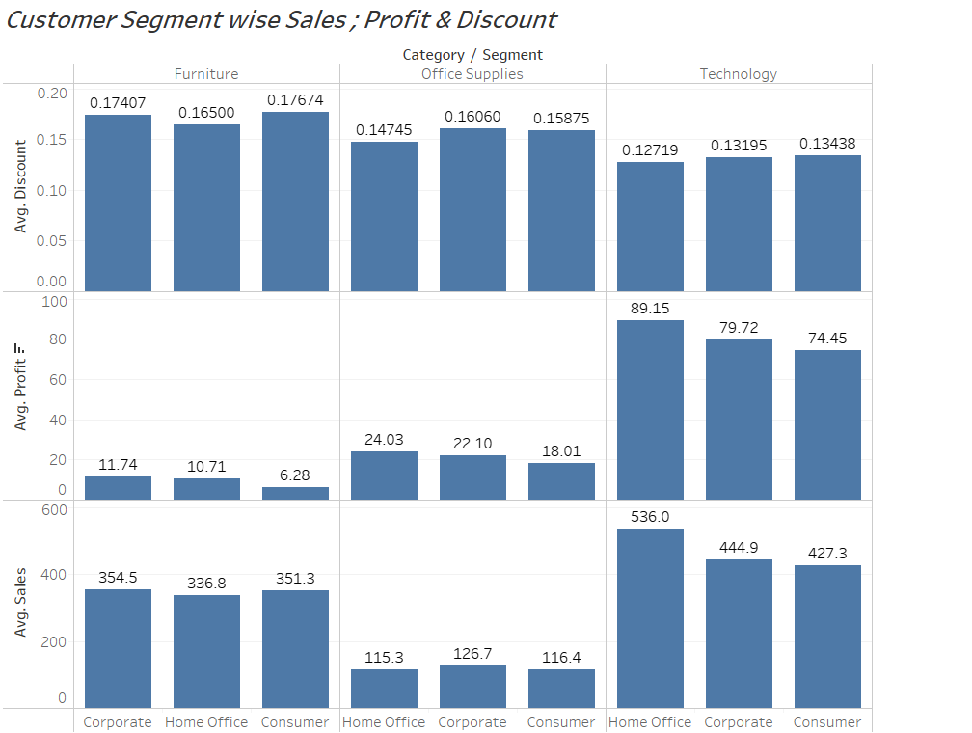
Bivariate Analysis -
Customer Segment wise Sales ; Profit & Discount analysis–
In the FURNITURE category of goods , while maximum SALES is generated by the Consumer segment of customers, this segment gives the Least profitability. The maximum discount is also given to the Consumer segment.
The ‘Home Office’ segment of customers gives sizable profitability as compared to the ‘Corporate’ segment , even after having lesser discounts availed.
Click for Live Visualisation

Slide 7
Bivariate Analysis -
Customer Segment wise Sales ; Profit & Discount analysis–
In the TECHNOLOGY category of goods , the ‘Home Office’ segment has shown the maximum sales with maximum profitability while the Discount released were the least.
The ‘Consumer’ segment has the minimum Sales, and the Least profitability.
Click for Live Visualisation

Slide 8
Bivariate Analysis -
Customer Segment wise Sales ; Profit & Discount analysis–
In the Office Supplies category of goods , the ‘Consumer’ segment has shown the maximum sales but with Least profitability while the Discount released were comparatively high.
The ‘Home Office’ segment has Less Sales but given maximum profitability with Least discounts shelled out
Click for Live Visualisation

Slide 9
Insights from EDA-
Category of Customers | FURNITURE | OFFICE SUPPLIES | TECHNOLOGY
HOME OFFICE | Least Sales; Less Profitable | Less Sales; Most Profitable | Most Sales; Most Profitable
CORPORATE | Most Sales; Most Profitable | Most Sales; Less Profitable | Less Sales; Less Profitable
CONSUMER | Less Sales; Least Profitable | Less Sales; Least Profitable | Least Sales; Least Profitable
Region -
The Central Region of the STORES is doing Bad. In the Furniture category of goods, it is even eating away the profits of the company.
For the CENTRAL Region – an exclusive Sales Strategy must be developed to INCREASE SALES and thereby increase profitability – for all category of goods.
The WEST Region sales and profitability performance can be taken as benchmark and strategies developed for the rest of the regions – for Furniture & Office Supplies categories.
The EAST Region Sales & Profitability for the Technology category can be adapted with regional changes – for the rest of the three regions.
REGION | FURNITURE | OFFICE SUPPLIES | TECHNOLOGY
WEST REGION | Most Sales; Most Profitable | Most Sales; Most Profitable | Less Sales; Less Profitability
SOUTH REGION | Least Sales; Less Profitable | Least Sales; Low Profitability | Least Sales ; Least Profitability
CENTRAL REGION | Low Sales; LOSS MAKING | Low Sales; Least Profitable | Low Sales; Low Profitability
EAST REGION | Less Sales; Least Profitable | Low Sales; Low Profitability | Most Sales; Most Profitable

Slide 10
Insights from EDA-
Category of Customers | FURNITURE | OFFICE SUPPLIES | TECHNOLOGY
HOME OFFICE | Least Sales; Less Profitable | Less Sales; Most Profitable | Most Sales; Most Profitable
CORPORATE | Most Sales; Most Profitable | Most Sales; Less Profitable | Less Sales; Less Profitable
CONSUMER | Less Sales; Least Profitable | Less Sales; Least Profitable | Least Sales; Least Profitable
Category of Customers -
Even with variable discounts offered across categories of goods, NO CUSTOMER Segment is bringing Loss to the STORES.
SALES to the Consumer segment is not benefitting the STORES as such. This means that the Consumer segment is not attracted to the STORES for buying ANY-OF-THE there category of goods.
High Pricing / Negative Sales strategy can be reasons for this LOW Sales.
An overhauling of SALES strategy with respect to the competitors in the market, needs to be adapted by the STORES – to increase sales and profitability in the CONSUMER Segment.
Fine-Tuning is the sales strategy is required with the ‘HOME OFFICE’ segment of customers to optimize sales.
When it comes to the CORPORATE Segment, a Sales strategy with Association rules can be thought of for increasing the sales of Technology products.
REGION | FURNITURE | OFFICE SUPPLIES | TECHNOLOGY
WEST REGION | Most Sales; Most Profitable | Most Sales; Most Profitable | Less Sales; Less Profitability
SOUTH REGION | Least Sales; Less Profitable | Least Sales; Low Profitability | Least Sales ; Least Profitability
CENTRAL REGION | Low Sales; LOSS MAKING | Low Sales; Least Profitable | Low Sales; Low Profitability
EAST REGION | Less Sales; Least Profitable | Low Sales; Low Profitability | Most Sales; Most Profitable

Slide 11


